Slide 1
Introduction to Real-Time Scheduling

Slide 2
Motivation for Scheduling
In the old days, each control task runs on a dedicated CPU
No RTOS, bare metal
No need for scheduling
Just make sure that task execution time < deadline
Now, multiple control tasks share one CPU
Multitasking RTOS
Need scheduling to make sure all tasks meet deadlines

Slide 3
Why Multiple Tasks?
The concept of concurrent tasks reflects the intuition about the functionality of embedded systems.
Task here can refer to either process or thread, depending on the underlying RTOS support
Tasks help us manage timing complexity:
multiple execution rates
multimedia
automotive
asynchronous input
user interfaces
communication systems

Slide 4
Engine Control
Processes:
spark control
crankshaft sensing
fuel/air mixture
oxygen sensor
Kalman filter – control algorithm

Slide 5
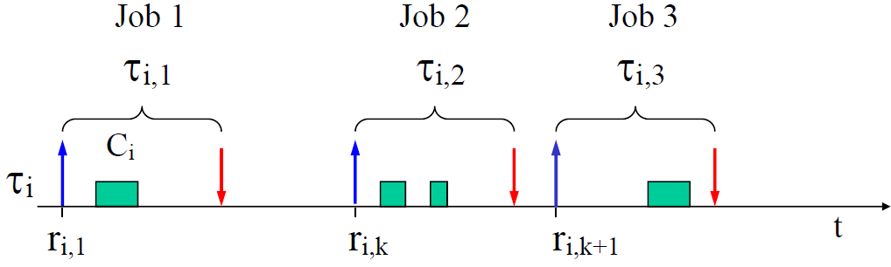
Definition: Task & Job
A task is an infinite sequence of jobs

Slide 6
Types of Tasks
Periodic task
Triggered at fixed periods by a timer
Aperiodic task
Triggered by external interrupts
Sporadic task
Triggered by external interrupts, but with minimum inter-arrival time (MIT) between interrupts
Can be treated as a periodic task with period equal to MIT
We typically assume periodic task model for schedulability analysis

Slide 7
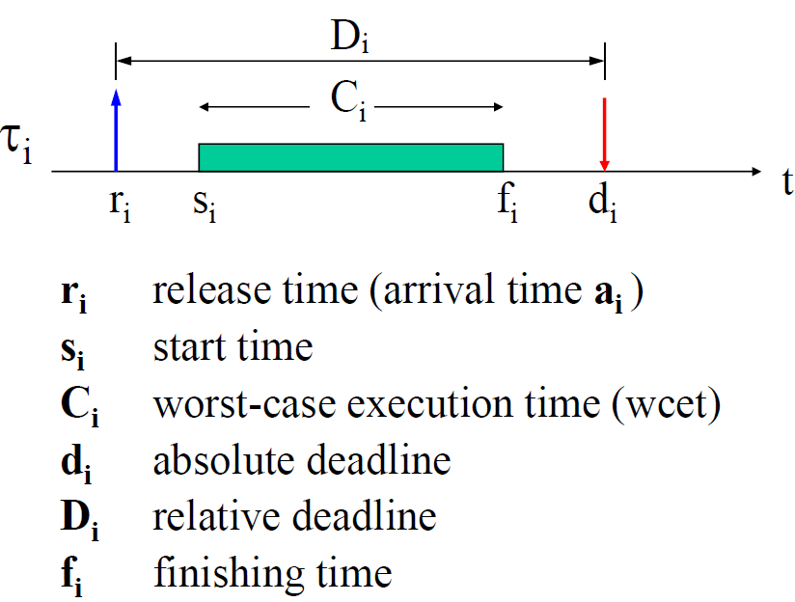
Periodic Task Params
Notes:
A schedule is said to be feasible, if all task can be completed according to a set of specified constraints.
A set of tasks is said to be schedulable, if there exists at least one algorithm that can produce a feasible schedule.
Arrival time or release time is the time at which a task becomes ready for execution.
Computation time is the time necessary to the processor for executing the task without interruption.
Deadline is the time at which a task should be completed.
Start time is the time at which a task starts its execution.
Finishing time is the time at which a task finishes its execution.

Slide 8
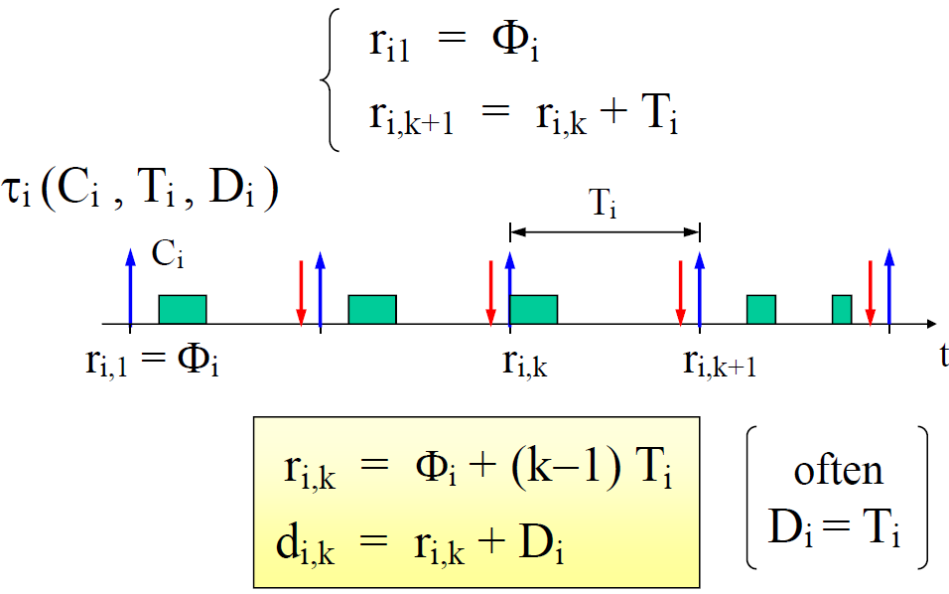
Periodic Task Model
Release Offset

Slide 9
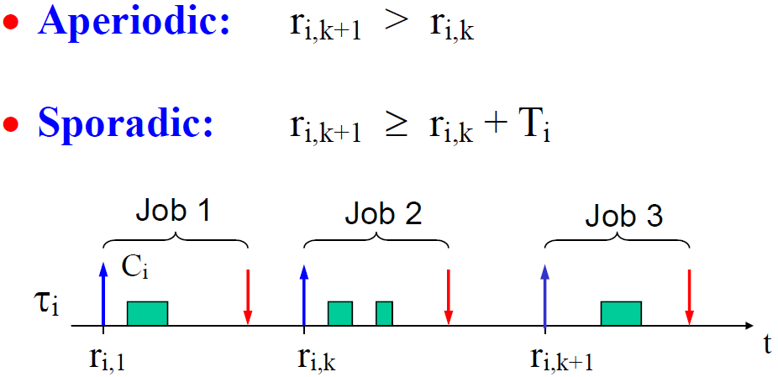
Aperiodic and Sporadic Task Model

Slide 10
Hard vs Soft RT Tasks
HARD tasks
All jobs must meet their deadlines. Missing deadlines may cause catastrophic consequences.
e.g., sensor reading, motor control.
SOFT tasks
Missing deadlines is not desirable but causes only Quality-of-Service(QoS) degradation.
e.g., reading data from keyboard, user command interpretation, message display
A system able to handle HARD tasks is a hard real-time system

Slide 11
The Scheduling Problem
Deciding the order of a set of tasks with certain known characteristics (periodicity, execution time) on a limited set of processing units, subject to a set of constraints on the completion time of each task.

Slide 12
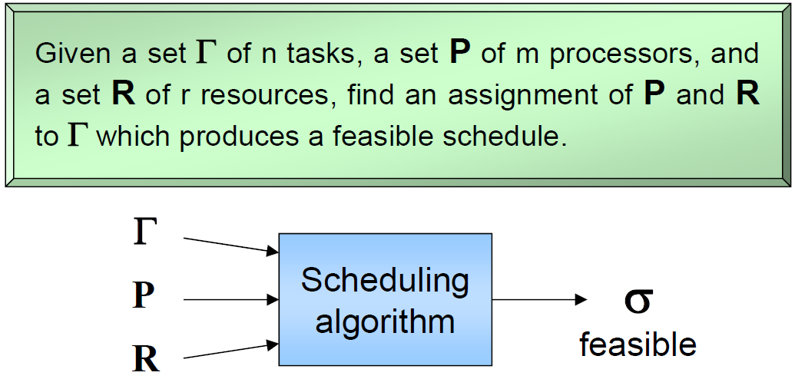
The General Scheduling Problem

Slide 13
Preemptive vs. Non-Preemptive
A scheduling algorithm is:
preemptive: if the active job can be temporarily suspended to execute a more important job.
non preemptive: if the active job cannot be suspended, i.e., always runs to completion.

Slide 14
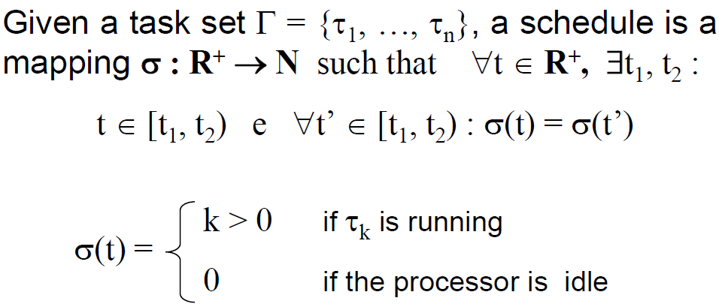
Schedule
When used as a noun, a schedule is an execution trace
When used as a verb, to schedule a taskset is to find a feasible schedule (noun)

Slide 15
Definitions
A schedule σ is feasible if all tasks meet their deadlines given a set of constraints
A taskset Γ is schedulable if there exists a feasible schedule for it

Slide 16
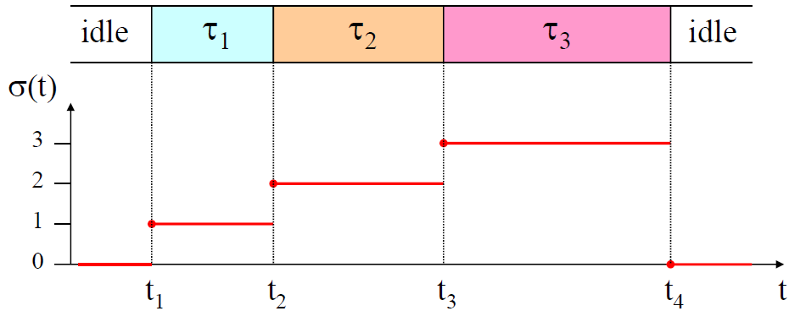
An Example Schedule
At time t₁, t₂, t₃, t₄, a context switch is performed

Slide 17
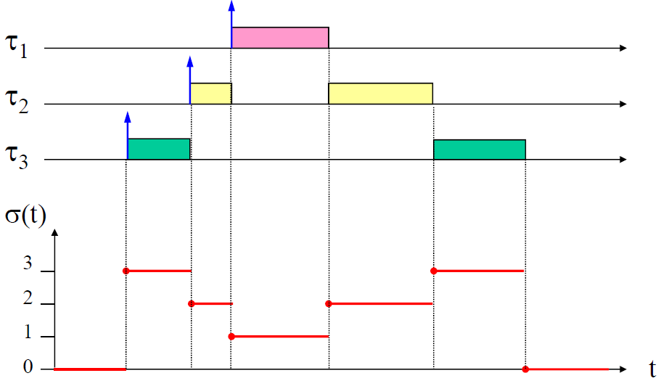
A Preemptive Schedule
Priority τ₁>τ₂>τ₃
Convention: higher-priority tasks are placed higher in the schedule chart

Slide 18
Types of Constraints
Timing constraints
activation, completion, jitter.
Precedence constraints
Relative ordering among task executions.
Resource constraints
Synchronization when accessing mutually-exclusive resources (shared data).

Slide 19
Precedence
Precedence relations between tasks can be described through an acyclic directed graph G, where tasks are represented by nodes and precedence relations by arrows. G induces a partial order on the task set.
There are different possible interpretations:
All successors of a task are activated (concurrent task execution).
One successor of a task is activated (non-deterministic choice).

Slide 20
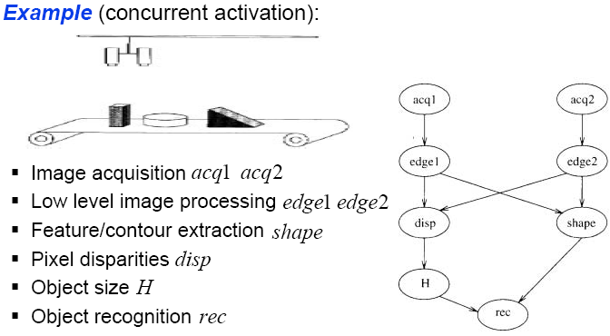
Example

Slide 21
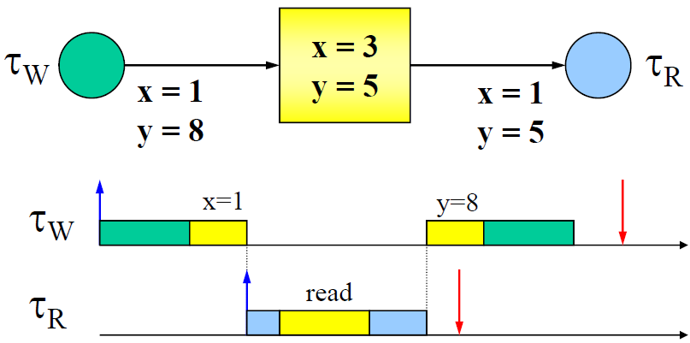
Resource Constraints
To ensure data consistency, shared data must be accessed in mutual exclusion
Example: the writer task τ_{W} writes to variables x and y; the reader task τ_{R} reads x and y. Assuming the programmer’s intention is to update the pair (x,y) atomically. Below is an erroneous scenario when τ_{R} reads a set of values (x,y)=(1,5). In the correct case, τ_{R} should read either (x,y)=(3,5) or (1,8).

Slide 22
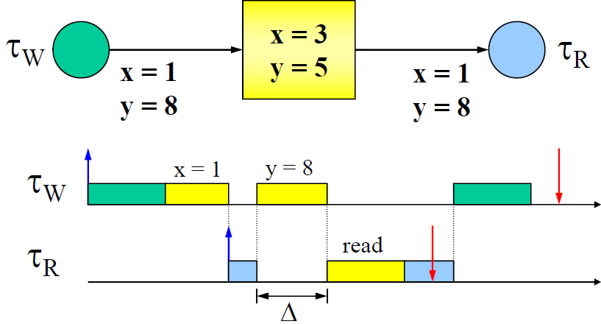
Adding Mutual Exclusion
Protecting the critical section (yellow part) with a lock ensures atomicity.

Slide 23
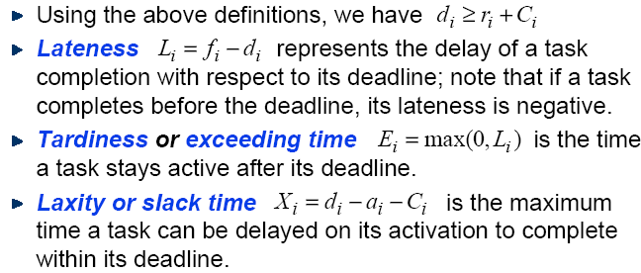
Scheduling Metrics

Slide 24
Example

Slide 25
Example

Slide 26
Different Scheduling Approaches
Static cyclic scheduling
All task invocation times are computed offline and stored in a table
Runtime dispatch is a simple table lookup
Fixed priority scheduling
Each task is assigned a fixed priority
Runtime dispatch is priority-based
Dynamic priority scheduling
Task priorities are assigned dynamically at runtime
E.g., earliest deadline first (EDF)

Slide 27
Cyclic Executive Scheduling
Execution timeline is an infinite sequence of hyper periods.
The same schedule is executed once during each hyper period.
Schedule is designed offline and stored in a table.
Runtime task dispatch is simple table lookup.
Pros:
Predictability
Low runtime overhead
Cons:
Task table can get very large if task periods are relatively prime
Maintenance nightmare
Not widely used
Except in certain
safety-critical systems

Slide 28
Simple Periodic TT Scheduler

Slide 29
Simple Periodic TT Scheduler Pseudo-Code

Slide 30
TT Cyclic Executive Scheduler

Slide 31
TT Cyclic Executive Scheduler Pseudo-Code

Slide 32
TT Scheduler Pros and Cons
Advantages:
Deals with precedence, exclusion, and distance constraints
Efficient, low-overhead for runtime task dispatch
Lock-free at runtime
Online monitoring and exception handling (babbling idiot prevention)
Disadvantages:
Not efficient for event-driven workload
Maintenance nightmare
Complete redesign when new tasks are added, or old tasks are deleted

Slide 33
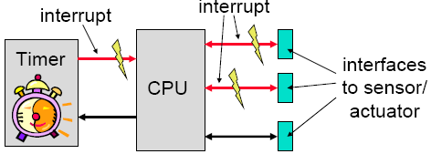
Event-Triggered (ET) Systems
Task release is triggered by external interrupts or events
Notes:
dynamic and adaptive: there are possible problems with respect to timing, the use of shared resources and buffer over-or underflow
guarantees can be given either off-line (if bounds on the behavior of the environment are known) or during run-time

Slide 34
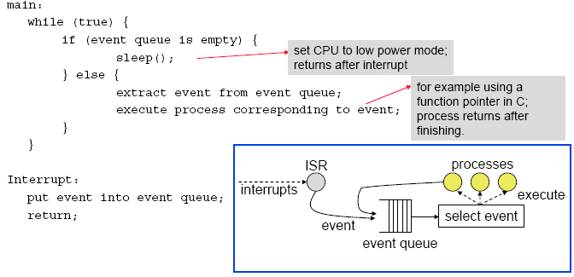
Non-Preemptive ET Scheduling Example
Notes:
Principle:
To each event, there is associated a corresponding process that will be executed.
Events are emitted by (a) external interrupts and (b) by processes themselves.
Events are collected in a queue; depending on the queuing discipline, an event is chosen for running.
Processes can not be interrupted.
Extensions:
A background process can run (and preempted!) if the event queue is empty.
Timed events enter the queue only after a time interval elapsed. This enables periodic instantiations for example.

Slide 35
Co-operative Multitasking
Each task allows a context switch at cswitch() call. OS scheduler chooses which task runs next.
Advantages:
predictable, where context switches can occur
less errors with use of shared resources
Problems:
real-time behavior at risk if it takes too long before context switch allowed

Slide 36
Example

Slide 37
Preemptive Multitasking

Slide 38
Fixed-Priority Scheduling

Slide 39
Fixed Priority Scheduling
Each task is assigned a fixed priority for all its invocations
Pros:
Predictability
Low runtime overhead
Temporal isolation during overload
Cons:
Cannot achieve 100% utilization in general, except when task periods are harmonic
Widely used in most commercial RTOSes and CAN bus

Slide 40
Rate Monotonic & Deadline Monotonic Scheduling
Rate Monotonic Scheduling (RMS)
Assign higher priority to task with smaller period
When D = T, RMS is the optimal priority assignment, i.e., if a taskset is not schedulable with RMS priority assignment, then it is not schedulable with any other fixed priority assignment
Deadline Monotonic Scheduling (DMS)
Assign higher priority to task with smaller relative deadline
When D < T, DMS is the optimal priority assignment
RTA also applies to DMS
Why do we want deadline < period?
Some events happen infrequently, but need to be handled urgently

Slide 41
Two Schedulability Analysis Approaches
Utilization bound test
Calculate total CPU utilization and compare it to a known bound
Polynomial time complexity
Pessimistic: sufficient but not necessary condition for schedulability
Response Time Analysis (RTA)
Calculate Worst-Case Response Time R_{i} for each task Tau_{i} and compare it to its deadline D_{i}
Pseudo-polynomial time complexity
Accurate: sufficient and necessary condition for schedulability

Slide 42
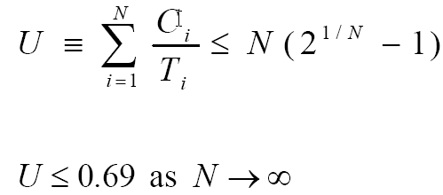
Utilization Bound Test
Assumes rate monotonic priority assignment
Task with smaller period is assigned higher priority
Sufficient but not necessary
Guaranteed to be schedulable if test succeeds
May still be schedulable even if test fails
If periods are harmonic, utilization bound is 100%

Slide 43
Utilization Bound Test Example
No. Tasks
Bound
1 | 100%
2 | 82.8%
3 | 78.0%
4 | 75.7%
5 | 74.3%
10 | 71.8%
inf | 69.3%

Slide 44
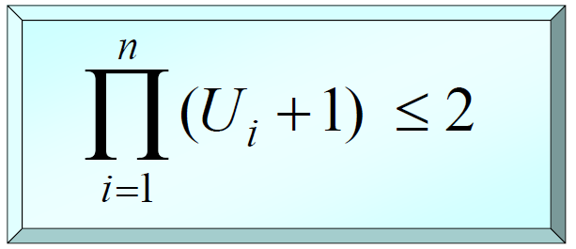
The Hyperbolic Bound
In 2000, Bini et al. proved that a set of n periodic tasks is schedulable with RM if:
This is a more accurate (less pessmistic) bound than Liu & Layland bound.

Slide 45
An Example Taskset
Utilization = 12/52 + 10/40 + 10/30 = 81%
Utilization bound (N = 3) = 78%
Utilization bound test fails
But taskset is actually schedulable
Task | T | D | C | Prio
1 | 30 | 30 | 10 | H
2 | 40 | 40 | 10 | M
3 | 52 | 52 | 12 | L

Slide 46
Schedule Timeline
If each task runs on a dedicated CPU:
T3
T2
T2
T1
T1
0
10
20
30
40
50
Time
If tasks share a single CPU:
T3
T3
T2
T2
T1
T1
0
10
20
30
40
50
Time

Slide 47
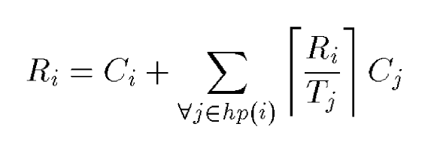
Response Time Analysis (RTA)
Assuming no resource sharing (no critical sections)
For synchronous taskset: all tasks are released at time 0 simultaneously. This is the worst-case: if the taskset is schedulable with this assumption, then it will be schedulable for any other release offset
Where hp(i) is the set of tasks with higher priority than task i
Solve this equation recursively for R_{i}
Let’s explain this equation with the example taskset
Notes:
Synchronous taskset: all tasks are released at time 0 simultaneously.
This is the worst-case: if taskset is schedulable with this assumption, then it will be schedulable for any other release offset

Slide 48
Task 1
Highest priority task, no interference from other tasks
R1 = C1 + 0 = 10
R1 < D1, so T1 is schedulable
T1
T1
0
10
20
30
40
50
Time

Slide 49
Task 2
Medium priority task
R2 = C2 + ceil(R2/T1)*C1 = 10 + ceil(R2/30)*10
Solve for R2 recursively, starting with R2 = C2 = 10:
R2 = 10 + ceil(10/30)*10 = 20
R2 = 10 + ceil(20/30)*20 = 20
Hence R2 = 20 < D2 = 40, so T2 is schedulable
T2
T2
T1
T1
0
10
20
30
40
50
Time

Slide 50
Task 3
Low priority task
R3 = C3 + ceil(R3/T1)*C1 + ceil(R3/T2)*C2 = 12 + ceil(R3/30)*10 + ceil(R3/40)*10
Solve for R3 recursively, starting with R3 = C3 = 12:
R3 = 12 + ceil(12/30)*10 + ceil(12/40)*10 = 32
R3 = 12 + ceil(32/30)*10 + ceil(32/40)*10 = 42
R3 = 12 + ceil(42/30)*10 + ceil(42/40)*10 = 52
R3 = 12 + ceil(52/30)*10 + ceil(52/40)*10 = 52
Hence R3 = 52 = D3 = 52, so T3 is schedulable
T3
T3
T2
T2
T1
T1
0
10
20
30
40
50
Time

Slide 51
Intuition behind RTA I
Initially R3 = 12
We have not taken into account any preemption yet from T1 and T2 yet
12
T3
T2
T2
T1
T1
0
10
20
30
40
50
Time

Slide 52
Intuition behind RTA II
R3 = 12 + ceil(12/30)*10 + ceil(12/40)*10 = 32
T1 preempts T3 once, and T2 preempts T3 once
32
T3
T2
T2
T1
T1
0
10
20
30
40
50
Time

Slide 53
Intuition behind RTA III
R3 = 12 + ceil(32/30)*10 + ceil(32/40)*10 = 42
T1 preempts T3 twice, and T2 preempts T3 once
42
T3
T3
T2
T2
T1
T1
0
10
20
30
40
50
Time

Slide 54
Intuition behind RTA IV
R3 = 12 + ceil(42/30)*10 + ceil(42/40)*10 = 52
T1 preempts T3 twice, and T2 preempts T3 twice
52
T3
T3
T2
T2
T1
T1
0
10
20
30
40
50
Time

Slide 55
Intuition behind RTA V
R3 = 12 + ceil(52/30)*10 + ceil(52/40)*10 = 52
T1 preempts T3 twice, and T2 preempts T3 twice
Recursive equation has converged, hence 52 is the worst-case response time of T3
52
T3
T3
T2
T2
T1
T1
0
10
20
30
40
50
Time

Slide 56
Preemptive vs. Non-Preemptive Scheduling

Slide 57
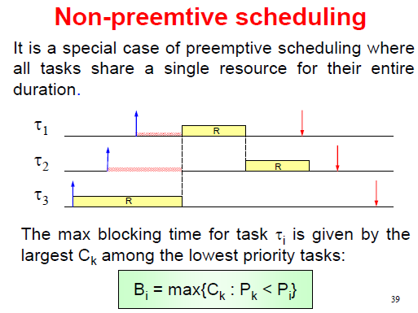

Slide 58
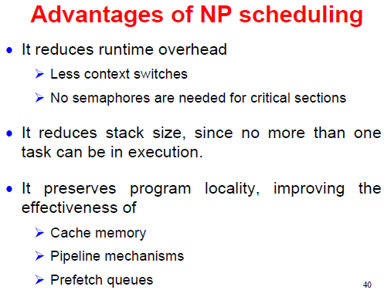

Slide 59
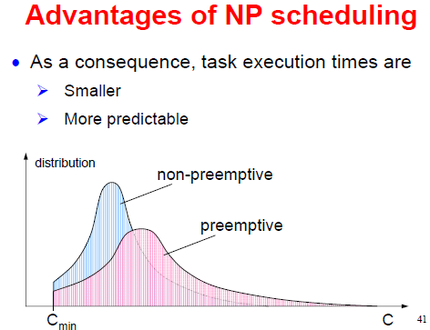

Slide 60
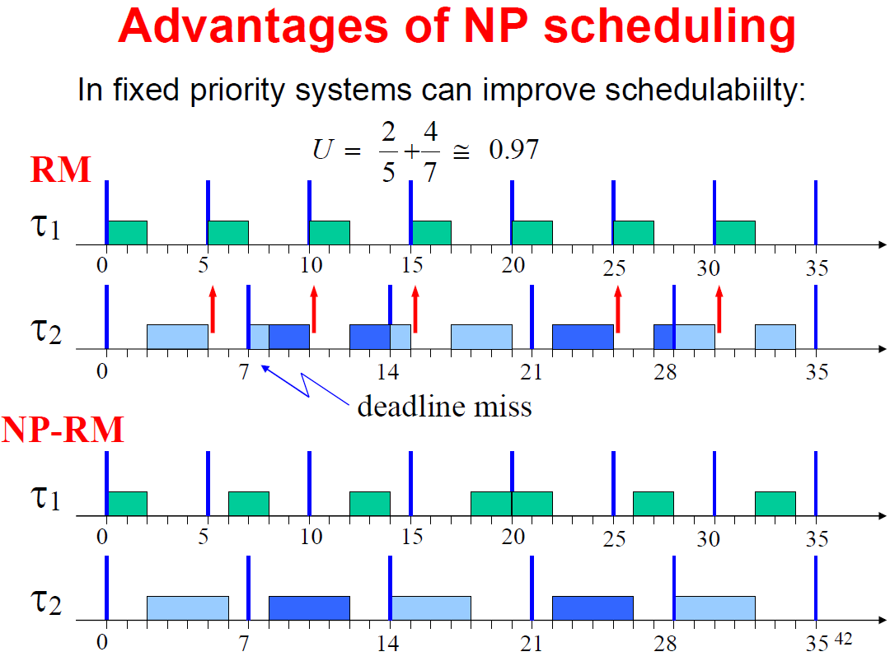

Slide 61
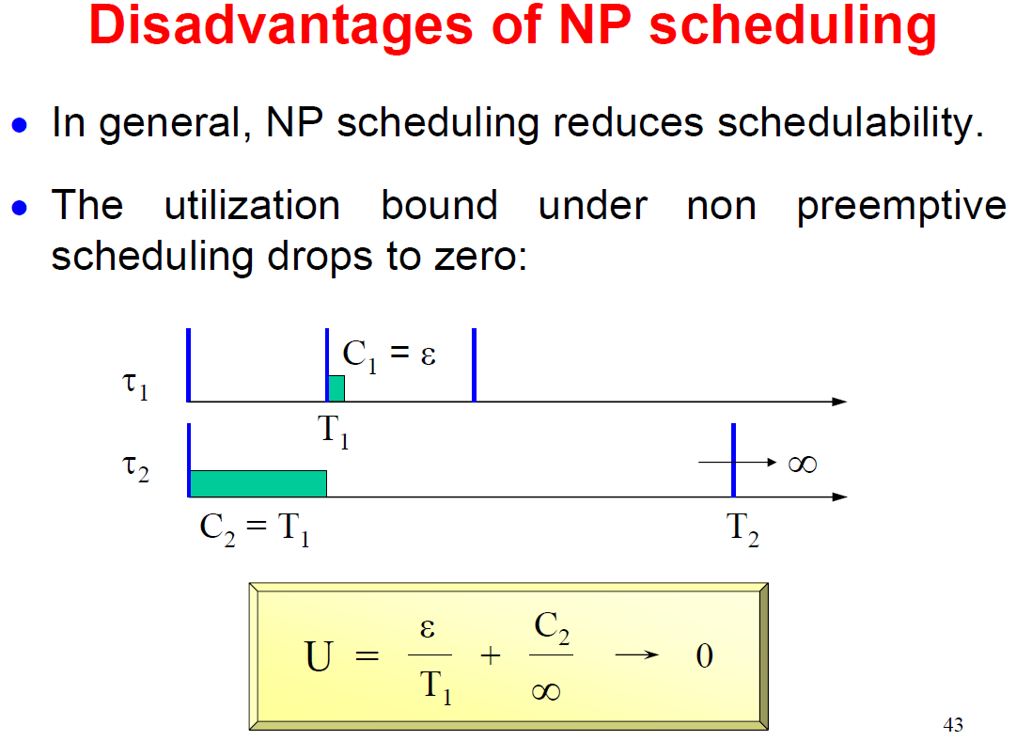
If C₂ (execution time of Tau₂)≥ T₁ (period of Tau₁), then system is non-schedulable with arbitrarily small utilization (when C₁ goes to 0 and T₂ goes to infinity)

Slide 62
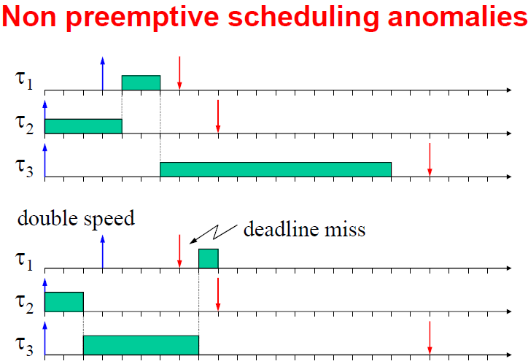
Scheduling anomaly: doubling the processor speed (reducing task execution times by half) makes Tau₁ miss its deadline

Slide 63
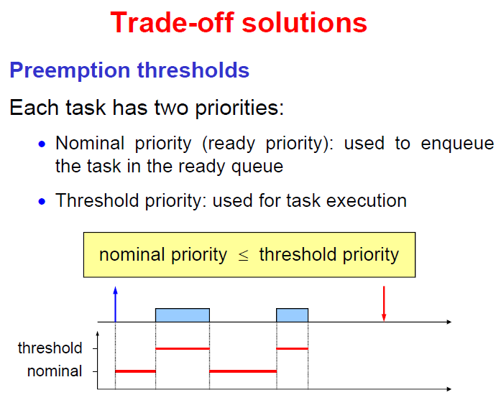
Tau₁ can preempt Tau₂ only if priority of Tau₁ is strictly greater than preemption threshold of Tau₂

Slide 64
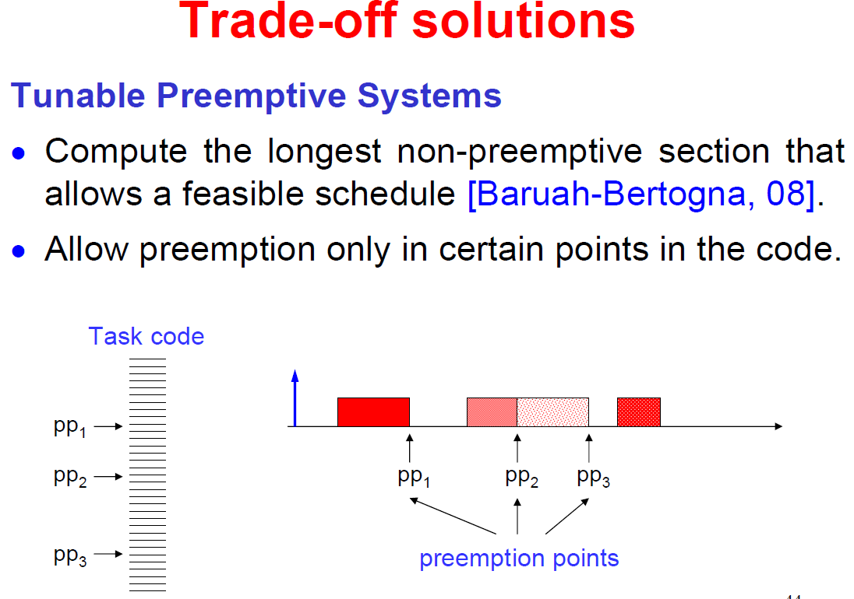
Insert yield() statements into task code as preemption points, while ensuring that any code segment between two consecutive yield() statements has execution time not exceeding the longest non-preemptive section

Slide 65
Jitters and How to Reduce Them

Slide 66
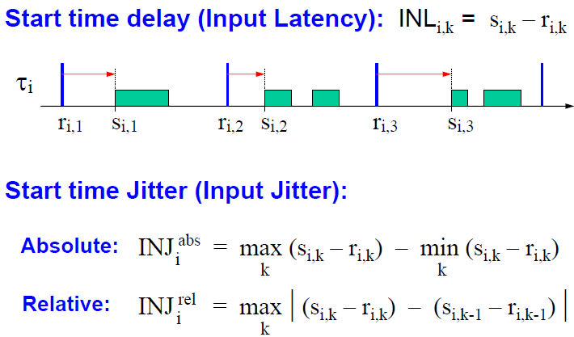
Definition of Input Jitter

Slide 67
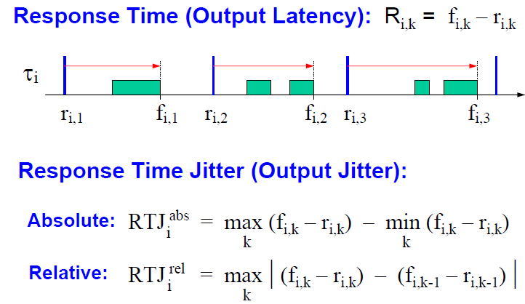
Definition of Output Jitter

Slide 68
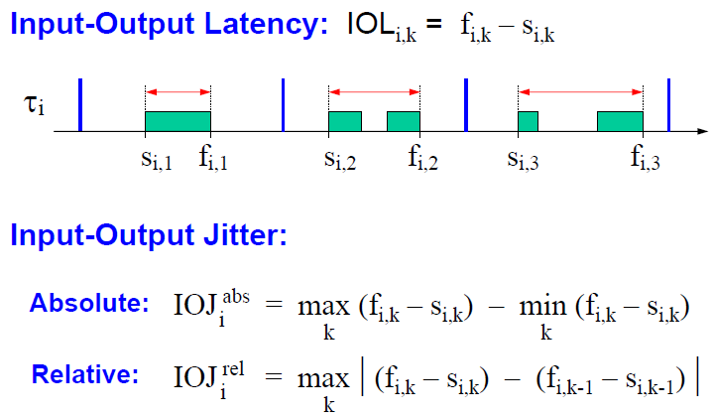
Definition of IO Jitter

Slide 69
Three Methods
Three methods can be used to reduce the jitter caused by task interference:
1. Task Splitting
2. Advancing Deadlines
3. Non Preemptive Scheduling

Slide 70
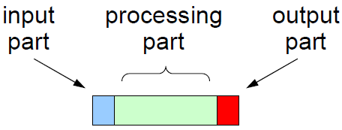
Task Splitting
Force input and output parts to execute in a time-triggered fashion, using timers:

Slide 71
Task Splitting: Advantages
Jitter is reduced at the minimum possible value;
If input and output parts are small, this method is effective for any task, independently of the scheduler and task parameters.

Slide 72
Task Splitting: Disadvantages
Extra implementation efforts
Jitter is reduced at the expense of increased delay
Input and output parts create extra interference which complicates the analysis and reduces schedulability;
Input and output parts may compete and need to be scheduled with some policy.

Slide 73
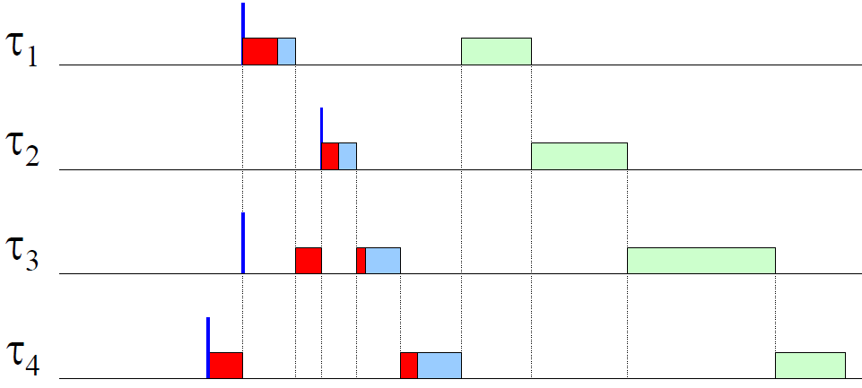
Interfering I/O parts

Slide 74
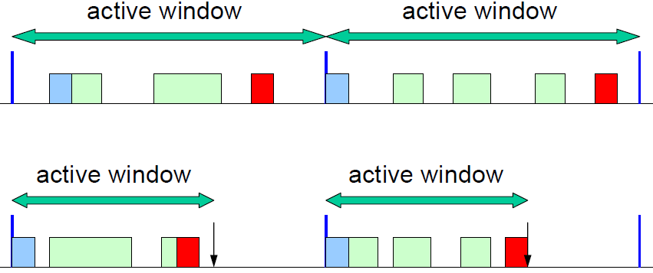
Advancing Deadlines
Advance (reduce) task deadlines to reduce the active window in which jobs can be executed:

Slide 75
Advancing Deadlines: Advantages
Easy to implement (no special support is required from the OS)
No extra interference caused by additional timer interrupts
Both delay and jitter are reduced

Slide 76
Advancing Deadlines: Disadvantages
Not all tasks can reduce jitter to zero.
Further reduction can be achieved by proper offsets, but the analysis requires exponential complexity.
Advancing deadlines reduces system schedulability.

Slide 77
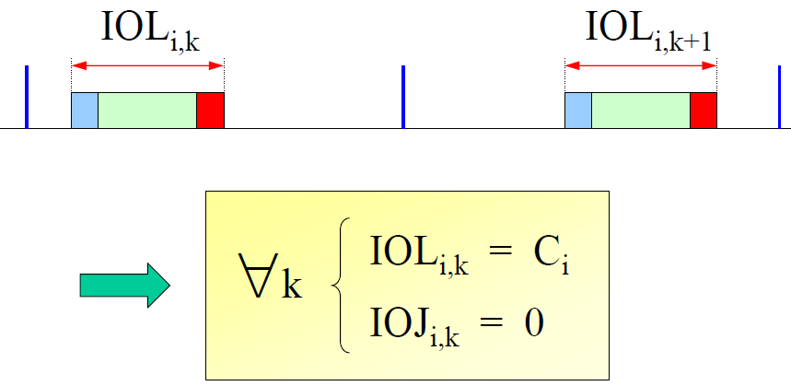
Non-Preemption
Adopt non-preemptive scheduling: a task can be delayed, but once started, it cannot be interrupted:

Slide 78
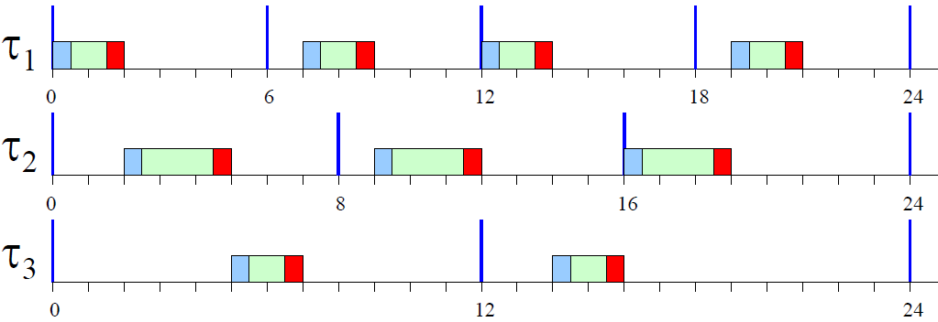
Non-Preemption: Example

Slide 79
Non-Preemption: Advantages
IOJ_{i} = 0 for all tasks
IOL_{i} = C_{i} for all tasks, simplifying the use of delay compensation techniques in control theory
Non-preemptive execution also simplifies resource management (there is no need to protect critical sections).
Non preemptive execution allows stack sharing and reduces required stack size

Slide 80
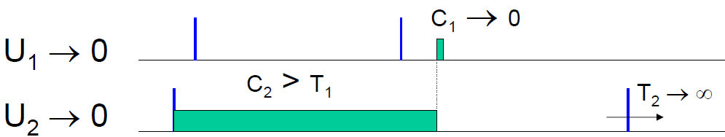
Non-Preemption: Disadvantages
Non preemption reduces schedulability (analysis must take blocking times into account);
Schedulable utilization bound drops to zero.
Here is an example with CPU utilization of nearly 0, yet non-schedulable.

Slide 81
Conclusions
I have given an overview of the basic concepts of real-time scheduling
Focus on static priority scheduling
Commercial tools from TimeSys and Tripac Software make it easier to do schedulability analysis
However, it is good to know the internals of these tools

